Slide 1
Employee Data Analysis using Excel
STUDENT NAME:R. Yuvadharani
REGISTER 312200214
Nm no: C1749D5FC1213228992451DED4D39D3B
DEPARTMENT:B.com ( general)
COLLEGE :S.I.V.E.T college gowrikkam chennai 600073.

Slide 2
PROJECT TITLE
Employee Performance Analysis using Excel

Slide 3


AGENDA
Problem Statement
Project Overview
End Users
Our Solution and Proposition
Dataset Description
Modelling Approach
Results and Discussion
Conclusion
3/21/2024 Annual Review

Slide 4

PROBLEM STATEMENT
The effectiveness of employee performance evaluation is crucial for organizational success. Many companies struggle with inconsistent performance metrics and subjective assessments. This leads to misaligned goals and employee dissatisfaction. Our analysis aims to identify key performance indicators (KPIs) that can be quantitatively assessed. By addressing these issues, we can enhance employee productivity and engagement

Slide 5

PROJECT OVERVIEW
This project focuses on analyzing employee performance data using Excel to derive actionable insights. We will utilize various analytical techniques to evaluate performance trends and identify areas for improvement. The project aims to create a user-friendly dashboard for ongoing performance monitoring. Our goal is to provide a comprehensive understanding of employee contributions to organizational objectives. This analysis will support data-driven decision-making processes

Slide 6

WHO ARE THE END USERS?
The primary end users of this analysis include HR managers, team leaders, and organizational executives. HR managers will benefit from improved performance evaluation processes. Team leaders can utilize insights to motivate and guide their teams effectively. Executives will gain a strategic overview of workforce performance, aiding in resource allocation and talent management. Ultimately, the findings will serve to enhance overall organizational performance.

Slide 7

OUR SOLUTION AND ITS VALUE PROPOSITION
We propose a structured approach to employee performance analysis using Excel, leveraging its powerful data manipulation and visualization capabilities. Our solution includes developing a performance dashboard that integrates various KPIs for real-time monitoring. We will provide training for end users to maximize the utility of the dashboard. By implementing our solution, organizations can foster a culture of continuous improvement and accountability. This approach will lead to more informed decision-making regarding employee development

Slide 8
Dataset Description
The dataset comprises employee performance metrics collected over the past year, including sales figures, project completion rates, and peer reviews. It includes demographic information such as department, tenure, and role. Data cleaning and preprocessing will be conducted to ensure accuracy and consistency. We will also incorporate qualitative feedback to provide a holistic view of performance. This comprehensive dataset will serve as the foundation for our analysis.

Slide 9

THE "WOW" IN OUR SOLUTION
The standout feature of our solution is the use of interactive dashboards in Excel. These dashboards will allow managers to filter data by department, time period, or individual employee, and see real-time visualizations of performance trends. This makes it easy for them to quickly identify high performers or areas that need attention.
3/21/2024 Annual Review
9

Slide 10
MODELLING
Our modeling approach will involve statistical analysis and data visualization techniques within Excel. We will employ regression analysis to identify relationships between performance metrics and outcomes. Additionally, we will use pivot tables and charts to summarize data effectively. The analysis will focus on identifying trends and patterns that can inform performance improvement strategies. This approach ensures that our findings are both robust and actionable.
10

Slide 11
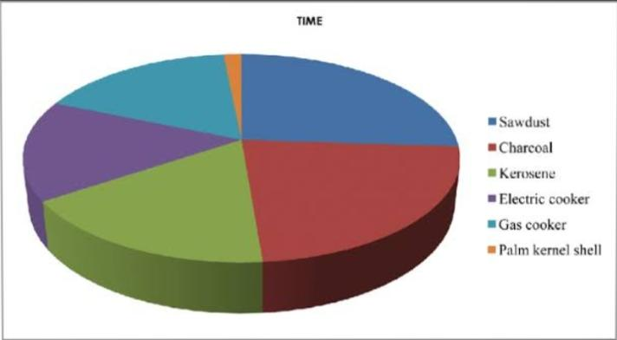
RESULTS
11

Slide 12
conclusion
In conclusion, our employee performance analysis using Excel provides valuable insights that can drive organizational success. By implementing a data-driven approach, companies can enhance their performance evaluation processes. The proposed solution empowers end users to make informed decisions based on reliable data. Future work may involve expanding the dataset and refining analytical techniques. Ultimately, this project aims to foster a culture of continuous improvement within the8:31

